Slide 1
Homomorphic Encryption Implementation for Small SWaP Platforms
2020.03.15
Daniel Achee
Jennifer Quintana

Slide 2
Project Introduction & Background

Slide 3
What is homomorphic encryption?
Homomorphic encryption:
An encryption scheme that allows the processing of data in its encrypted form without access to the secret key
Preserves the structure of the underlying data
Some developed using public asymmetric key systems, such as
RSA
ElGamal
Paillier
Encryption schemes can be fully homomorphic or partially homomorphic, with respect to one type of data operation (i.e. multiplication, addition)

Slide 4
Types of Homomorphic Encryption
Year | Acronym | Name | Description
2011 | BGV | Brakerski-Gentry-Vaikuntanathan | RLWE lattice-based FHE
2011 | BFV | Brakerski-Fan-Vercauteren | RLWE lattice-based FHE
2016 | CKKS | Cheon-Kim-Kim-Song | Supports approx. arithmetics over complex numbers. Exploits ring isomorphism.
There are many homomorphic encryption schemes, including Enhanced Homomorphic Cryptosystem (EHC), Algebra Homomorphic Encryption (AHEE), and Non-interactive Exponential Homomorphic Encryption Scheme (NEHE); however, we focused most on BFV and CKKS, as they had the most materials available to researchers for free.

Slide 5

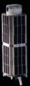
Project Motivation: Space Applications, IoT Devices
Secure computation for space applications:
Cubesats for proprietary research missions with low-SWaP processors can transmit their encrypted data, and securely have data processed and transmitted back, using homomorphic encryption
Client-server model

Slide 6
Project Objectives
Analyze and implement a series of homomorphic encryption functions
Small SWaP Platform:
small SoCFPGA
FPGA-only
ARM processor only
Benchmark homomorphic encryption algorithms on cloud computing service
Amazon AWS EC2 cloud computing service
Implement client-server model
Modification of SEAL libraries to split computing requirements for implementation
Uses a combination of small SWaP device and a cloud computing service

Slide 7
Homomorphic Encryption Library: Microsoft SEAL (MIT)
Simple Encrypted Arithmetic Library (SEAL):
Open-source software library developed by Microsoft
Implements various forms of homomorphic encryption
Standard C/C++ (no external dependencies)
Supports both asymmetric and symmetric encryption algorithms
Supports both BFV and CKKS encryption schemes

Slide 8
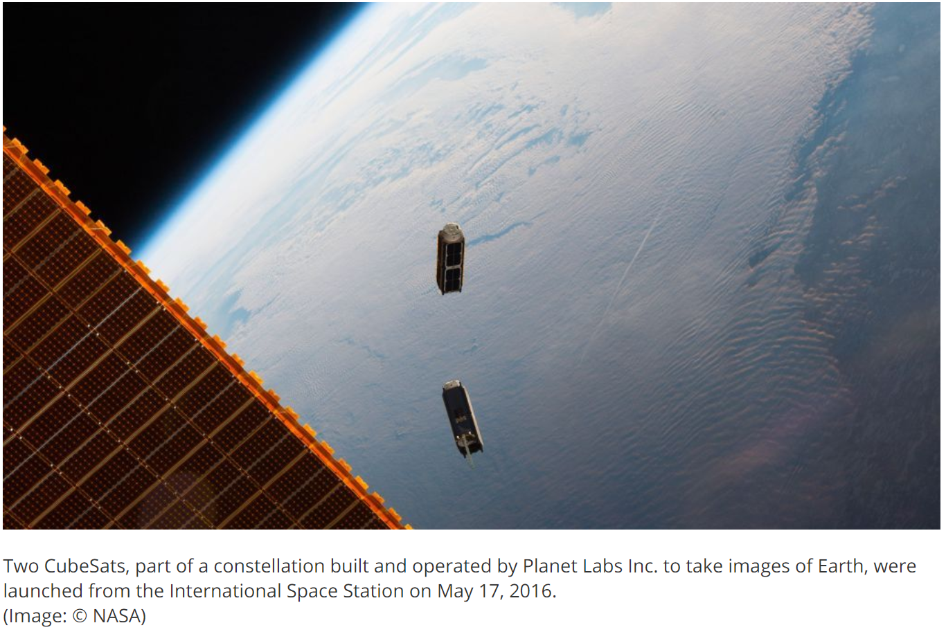
Technical Approach
Implement a low-SWaP client-server model for expanded use of homomorphic encryption schemes
Some existing experiments for IoT devices and high-performance computing platforms
Limited implementations achievable with Raspberry Pi in literature
No current literature on low-SWaP space applications
Desire for better encryption for cubesat and small sats, resistance to quantum computing for forced decryption
No library of functions for FPGA implementation commercially available
Some in-work at IBM, pay for access
Relevant current solicitation for research FY2020 – FY2023:
AFRL BAA Capabilities for Cyber Resiliency
AFRL BAA Foundations of Trusted Computational Information Systems
NAVAIR BAA Cyber Warfare Detachment
AFRL BAA Next Generation Intelligence Collection and Analysis
AFRL BAA Measurement and Signatures Intelligence Exploitation

Slide 9
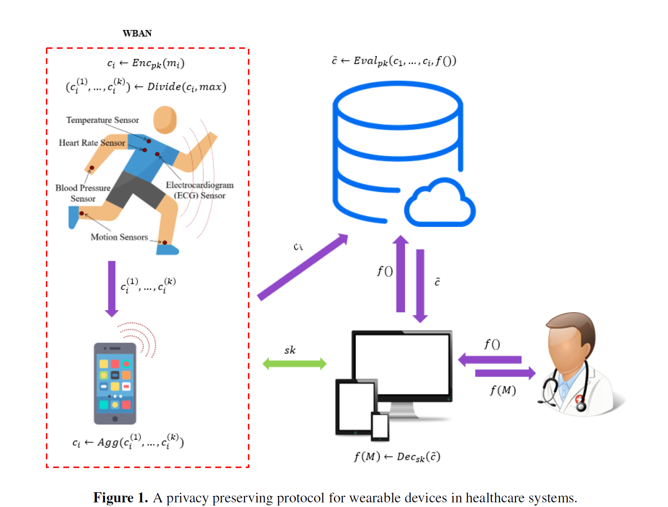
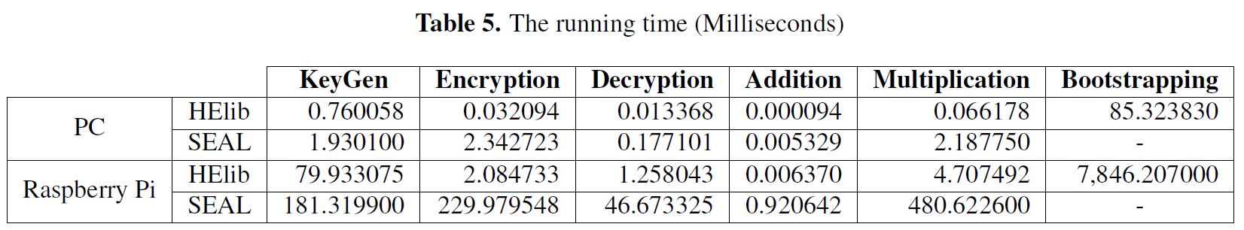
Related Work
Simulated WBAN through OMNET++ and Castalia
30s interval for reading and writing encrypted data
Simulation time 3600 s
Simulation with Helib and SEAL
Measured packet delay
A. Prasitupparote, et. Al., “Implementation and Analysis of Fully Homomorphic Encryption in Wearable Devices”, Proceedings of 4th International Conference on Information Security and Digital Forensics, ISDF2018, Greece, 2018.

Slide 10
Objective 1

Slide 11
Objective 1: Small SWaP Platform Analysis
Item No. | Manufacturer | Device Description | Platform Type
1 | Intel | DE10 Nano SoC (Cyclone V) | SoC (ARM + FPGA)
2 | Intel | DE0 Nano (Cyclone IV) | FPGA
3 | Xilinx | Arty A7 (Zynq 7020) | SoC (ARM + FPGA)
4 | Texas Instruments | MSP430 LaunchPad | Microcontroller
5 | Raspberry Pi | Rpi 4 | ARM Processor
Criteria examined:
Power consumption
Processor type
FPGA number of programmable logic elements
Physical size
Cost

Slide 12
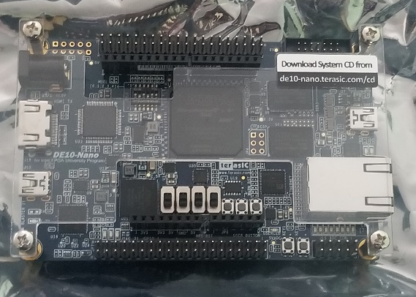
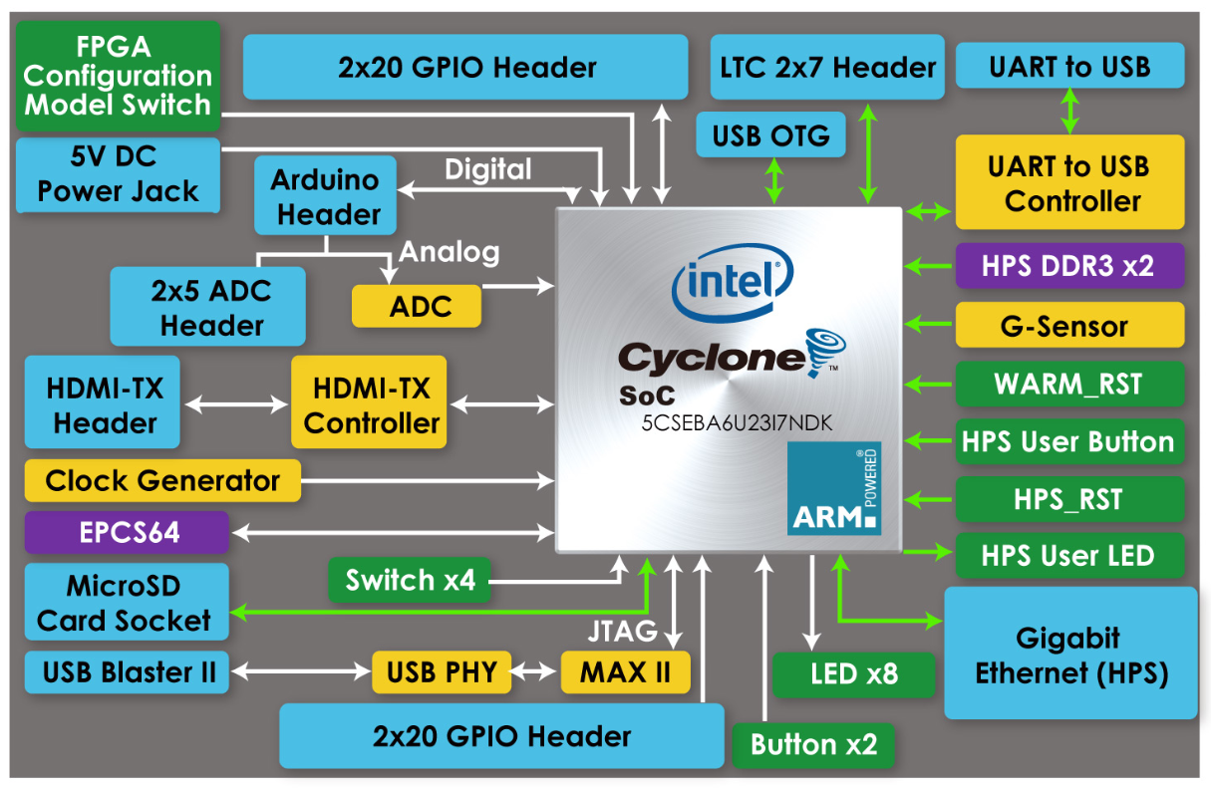
Objective 1: Small SWaP Platform Selection 1
Intel Cyclone V: DE10 Nano SoC
SoCFGPA
Dual-core Cortex A9 32-bit ARM processor
110k Programmable Logic Elements
Linux OS:
Yocto Poky Distro
Boot from 32GB SD card

Slide 13
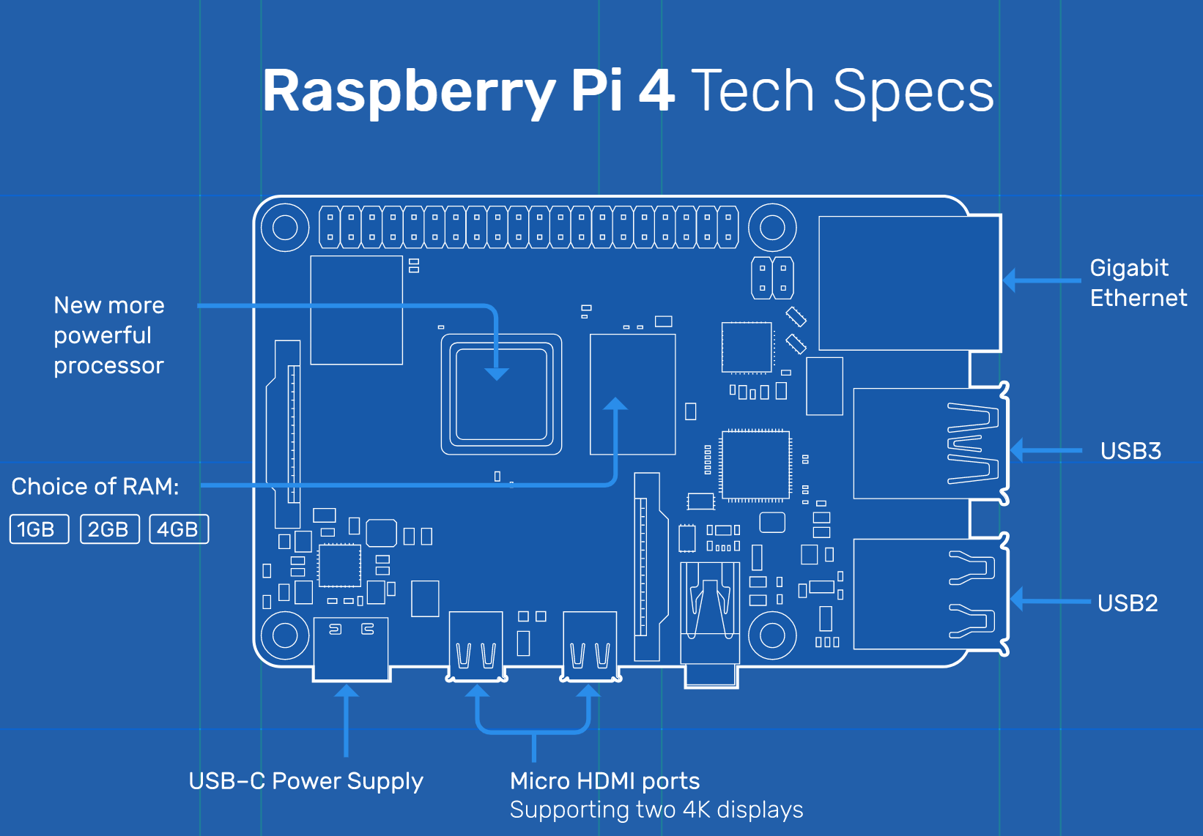
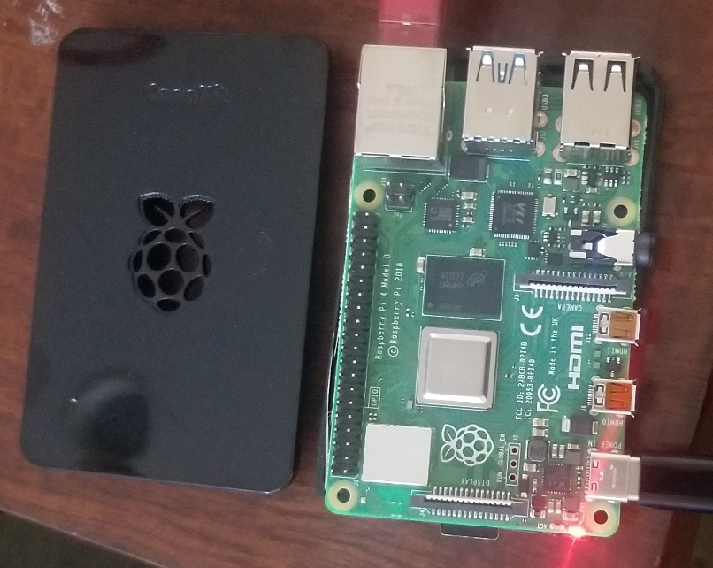
Objective 1: Small SWaP Platform Selection 2
Raspberry Pi 4
Cortex A72 quad-core 64-bit ARM processor
4GB DDR3 memory

Slide 14
Objective 1: Implementation
Using both DE10 Nano SoC and Raspberry Pi 4, we attempted to compile the SEAL library functions and run on the platform.
Using DE10 Nano SoC ARM processor
Porting C -> HDL on DE10 Nano SoC FPGA
Using Raspberry Pi 4 ARM processor

Slide 15
Objective 1: Results
32-bit processor incompatible with SEAL and similar available homomorphic encryption libraries.
Requires at least 64-bit processor.
HDL -> C implementation too large for Cyclone V FPGA
Success with Raspberry Pi 4 Cortex A78 ARM processor
All instances runnable for degrees <32768

Slide 16
Objective 1: Results (2)
# | Parameter | SEAL BFV Degree Computation Time [ms]
Degree |  | 1024 | 2048 | 4096 | 8192 | 16384
1 | Average Batch | 0.233 | 0.466 | 0.984 | 2.092 | 4.435
2 | Average Unbatch | 0.186 | 0.344 | 0.740 | 1.569 | 3.373
3 | Average Encrypt | 3.329 | 6.524 | 22.071 | 64.670 | 219.878
4 | Average Decrypt | 1.566 | 2.417 | 7.137 | 26.089 | 100.465
5 | Average Add | 0.025 | 0.036 | 0.116 | 0.498 | 2.047
6 | Average Multiply | 11.460 | 22.102 | 74.159 | 279.802 | 1,146.392
7 | Average Multiply Plain | 1.006 | 2.076 | 8.810 | 37.527 | 158.410
8 | Average Square | 8.252 | 16.237 | 55.181 | 209.815 | 867.853
9 | Average Relinearize | N/A | N/A | 16.476 | 72.648 | 396.322
10 | Average Rotate 1 step | N/A | N/A | 16.613 | 73.975 | 400.704
11 | Average Rotate Random | N/A | N/A | 53.823 | 341.561 | 1,765.455
12 | Average Rotate Columns | N/A | N/A | 16.624 | 73.992 | 400.718
13 | CPU Usage [%] | 5.0 % | 10.6% | 87.7% | 99.7% | 100%

Slide 17
Objective 1: Results (3)
# | Parameter | SEAL CKKS Degree Computation Time [ms]
Degree |  | 1024 | 2048 | 4096 | 8192 | 16384
1 | Average Batch | 1.801 | 2.969 | 7.514 | 20.257 | 61.416
2 | Average Unbatch | 2.594 | 4.250 | 14.735 | 57.825 | 257.827
3 | Average Encrypt | 3.016 | 4.455 | 21.417 | 66.505 | 232.468
4 | Average Decrypt | 0.148 | 0.215 | 0.842 | 3.325 | 13.085
5 | Average Add | 0.027 | 0.036 | 0.114 | 0.446 | 1.998
6 | Average Multiply | 0.427 | 0.729 | 2.951 | 12.627 | 48.889
7 | Average Multiply Plain | 0.186 | 0.316 | 1.243 | 4.921 | 19.506
8 | Average Square | 0.302 | 0.517 | 2.137 | 9.173 | 36.203
9 | Average Relinearize | N/A | N/A | 16.323 | 71.417 | 391.350
 | Average Rescale | N/A | N/A | 6.235 | 30.999 | 140.706
10 | Average Rotate 1 step | N/A | N/A | 16.734 | 73.160 | 399.765
11 | Average Rotate Random | N/A | N/A | 57.636 | 279.600 | 1,790.253
12 | Average Complex Conjugate | N/A | N/A | 16.684 | 73.036 | 398.881
13 | CPU [%] | 7.0% | 11.6% | 81.1% | 98.3% | 100%

Slide 18
Objective 2

Slide 19
Objective 2: AWS EC2 Selection
Item No. | Instance Name | Instance Type | CPU Cores | Memory
1 | t1.micro | General Purpose | 1 | 0.5 GB
2 | c5n.large | Computation Optimized | 2 | 4 GB
3 | t2.micro | General Purpose | 1 | 1 GB
4 | r5a.large | Memory Optimized | 2 | 16 GB
Selected different instances based on processing properties:
Large, high-capability instances
Small, resource-limited instances

Slide 20
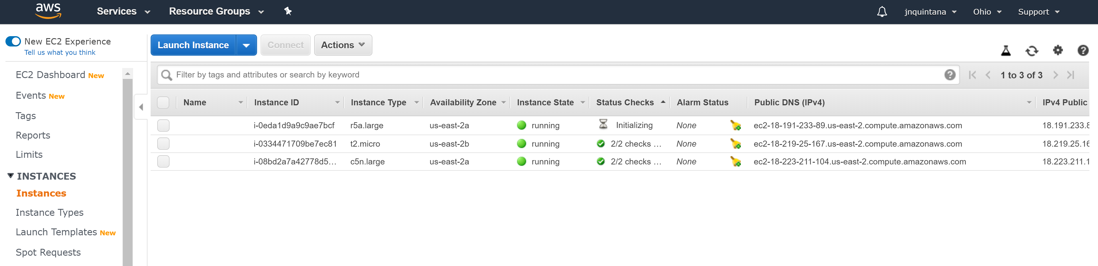
Objective 2: Implementation (1)
Instantiated AWS EC2:
Ubuntu 18.04 OS used for instantiations
SSH to EC2 to run performance metrics for different functional implementations of SEAL benchmarking

Slide 21
Objective 2: Results for t2_micro instance - BFV
# | Parameter | SEAL BFV Degree Computation Time [ms]
Degree |  | 1024 | 2048 | 4096 | 8192 | 16384
1 | Average Batch | 0.024 | 0.050 | 0.129 | 0.273 | 0.539
2 | Average Unbatch | 0.026 | 0.048 | 0.105 | 0.214 | 0.453
3 | Average Encrypt | 0.537 | 1.034 | 3.034 | 8.262 | 26.371
4 | Average Decrypt | 0.118 | 0.234 | 0.764 | 2.671 | 11.488
5 | Average Add | 0.005 | 0.008 | 0.034 | 0.112 | 0.430
6 | Average Multiply | 1.103 | 2.180 | 7.349 | 27.757 | 116.834
7 | Average Multiply Plain | 0.113 | 0.234 | 0.931 | 4.047 | 19.624
8 | Average Square | 0.754 | 1.509 | 5.038 | 20.058 | 82.345
9 | Average Relinearize | N/A | N/A | 1.496 | 7.331 | 42.251
10 | Average Rotate 1 step | N/A | N/A | 1.549 | 7.354 | 43.365
11 | Average Rotate Random | N/A | N/A | 6.213 | 31.027 | 205.262
12 | Average Rotate Columns | N/A | N/A | 1.493 | 7.360 | 42.124
13 | CPU Usage [%] | 1% | 2.3% | 16.6% | 51.8% | 89.7%

Slide 22
Objective 2: Results for t2_micro instance - CKKS
# | Parameter | SEAL CKKS Degree Computation Time [ms]
Degree |  | 1024 | 2048 | 4096 | 8192 | 16384
1 | Average Batch | 0.496 | 1.055 | 2.467 | 6.197 | 17.045
2 | Average Unbatch | 0.558 | 1.182 | 3.273 | 11.141 | 46.447
3 | Average Encrypt | 0.508 | 0.950 | 3.376 | 9.462 | 31.022
4 | Average Decrypt | 0.015 | 0.026 | 0.112 | 0.405 | 1.705
5 | Average Add | 0.006 | 0.009 | 0.030 | 0.105 | 0.418
6 | Average Multiply | 0.053 | 0.088 | 0.345 | 1.364 | 5.432
7 | Average Multiply Plain | 0.014 | 0.023 | 0.091 | 0.375 | 1.453
8 | Average Square | 0.035 | 0.064 | 0.251 | 1.015 | 4.191
9 | Average Relinearize | N/A | N/A | 1.530 | 7.811 | 43.702
 | Average Rescale | N/A | N/A | 0.733 | 3.516 | 15.965
10 | Average Rotate 1 step | N/A | N/A | 1.750 | 8.344 | 47.054
11 | Average Rotate Random | N/A | N/A | 7.205 | 31.284 | 227.630
12 | Average Complex Conjugate | N/A | N/A | 1.757 | 8.244 | 46.406
13 | CPU [%] | 1.0% | 1.7% | 15.0% | 46.2% | 100%

Slide 23
Objective 2: Results for c5n_large instance - BFV
# | Parameter | SEAL BFV Degree Computation Time [ms]
Degree |  | 1024 | 2048 | 4096 | 8192 | 16384
1 | Average Batch | 0.025 | 0.054 | 0.105 | 0.213 | 0.425
2 | Average Unbatch | 0.023 | 0.039 | 0.083 | 0.168 | 0.352
3 | Average Encrypt | 0.421 | 0.786 | 2.274 | 6.227 | 19.964
4 | Average Decrypt | 0.082 | 0.165 | 0.541 | 1.920 | 7.527
5 | Average Add | 0.004 | 0.006 | 0.018 | 0.073 | 0.309
6 | Average Multiply | 0.747 | 1.571 | 5.255 | 20.001 | 81.804
7 | Average Multiply Plain | 0.081 | 0.169 | 0.712 | 2.999 | 12.707
8 | Average Square | 0.522 | 1.071 | 3.612 | 13.791 | 57.450
9 | Average Relinearize | N/A | N/A | 1.078 | 5.273 | 31.282
10 | Average Rotate 1 step | N/A | N/A | 1.083 | 5.310 | 31.056
11 | Average Rotate Random | N/A | N/A | 4.467 | 20.178 | 136.762
12 | Average Rotate Columns | N/A | N/A | 1.082 | 5.291 | 30.989
13 | CPU Usage [%] | 1.0% | 1.7% | 12.0% | 36.7% | 100%

Slide 24
Objective 2: Results for c5n_large instance - CKKS
# | Parameter | SEAL CKKS Degree Computation Time [ms]
Degree |  | 1024 | 2048 | 4096 | 8192 | 16384
1 | Average Batch | 0.364 | 0.788 | 1.802 | 4.487 | 12.292
2 | Average Unbatch | 0.390 | 0.831 | 2.325 | 8.039 | 33.520
3 | Average Encrypt | 0.422 | 0.792 | 2.643 | 7.334 | 23.595
4 | Average Decrypt | 0.009 | 0.016 | 0.063 | 0.245 | 1.041
5 | Average Add | 0.004 | 0.006 | 0.017 | 0.068 | 0.284
6 | Average Multiply | 0.024 | 0.048 | 0.179 | 0.841 | 3.900
7 | Average Multiply Plain | 0.009 | 0.016 | 0.060 | 0.239 | 0.950
8 | Average Square | 0.016 | 0.032 | 0.120 | 0.552 | 2.763
9 | Average Relinearize | N/A | N/A | 1.097 | 5.357 | 31.338
 | Average Rescale | N/A | N/A | 0.519 | 2.574 | 11.756
10 | Average Rotate 1 step | N/A | N/A | 1.280 | 6.155 | 34.147
11 | Average Rotate Random | N/A | N/A | 4.458 | 28.515 | 145.624
12 | Average Complex Conjugate | N/A | N/A | 1.275 | 6.045 | 33.749
13 | CPU [%] | 0.7% | 1.3% | 11.0% | 41.3% | 100%

Slide 25
Objective 2: Results for r5a_large instance - BFV
# | Parameter | SEAL BFV Degree Computation Time [ms]
Degree |  | 1024 | 2048 | 4096 | 8192 | 16384
1 | Average Batch | 0.056 | 0.056 | 0.124 | 0.273 | 0.513
2 | Average Unbatch | 0.022 | 0.046 | 0.091 | 0.196 | 0.451
3 | Average Encrypt | 0.482 | 0.902 | 2.604 | 7.491 | 24.381
4 | Average Decrypt | 0.102 | 0.186 | 0.632 | 2.374 | 9.425
5 | Average Add | 0.005 | 0.007 | 0.020 | 0.083 | 0.327
6 | Average Multiply | 1.002 | 1.986 | 6.581 | 25.472 | 103.115
7 | Average Multiply Plain | 0.102 | 0.206 | 0.930 | 3.827 | 16.475
8 | Average Square | 0.676 | 1.390 | 4.609 | 18.096 | 74.667
9 | Average Relinearize | N/A | N/A | 1.270 | 6.631 | 39.109
10 | Average Rotate 1 step | N/A | N/A | 1.322 | 6.585 | 39.271
11 | Average Rotate Random | N/A | N/A | 4.299 | 24.564 | 162.075
12 | Average Rotate Columns | N/A | N/A | 1.287 | 6.708 | 39.196
13 | CPU Usage [%] | 1.7% | 2.3% | 14.0% | 63.1% | 98%

Slide 26
Objective 2: Results for r5a_large instance - CKKS
# | Parameter | SEAL CKKS Degree Computation Time [ms]
Degree |  | 1024 | 2048 | 4096 | 8192 | 16384
1 | Average Batch | 0.479 | 1.080 | 2.227 | 5.365 | 14.436
2 | Average Unbatch | 0.536 | 1.102 | 3250 | 10.403 | 44.064
3 | Average Encrypt | 0.481 | 0.855 | 3.145 | 8.735 | 28.172
4 | Average Decrypt | 0.012 | 0.022 | 0.091 | 0.302 | 1.229
5 | Average Add | 0.004 | 0.007 | 0.022 | 0.075 | 0.311
6 | Average Multiply | 0.033 | 0.066 | 0.268 | 0.984 | 4.578
7 | Average Multiply Plain | 0.013 | 0.024 | 0.100 | 0.351 | 1.500
8 | Average Square | 0.022 | 0.045 | 0.179 | 0.677 | 3.103
9 | Average Relinearize | N/A | N/A | 1.449 | 6.599 | 38.316
 | Average Rescale | N/A | N/A | 0.667 | 3.164 | 14.578
10 | Average Rotate 1 step | N/A | N/A | 1.623 | 7.275 | 41.515
11 | Average Rotate Random | N/A | N/A | 5.934 | 28.260 | 181.675
12 | Average Complex Conjugate | N/A | N/A | 1.579 | 7.215 | 41.180
13 | CPU [%] | 0.7% | 2% | 13.3% | 48.7% | 93.4%

Slide 27
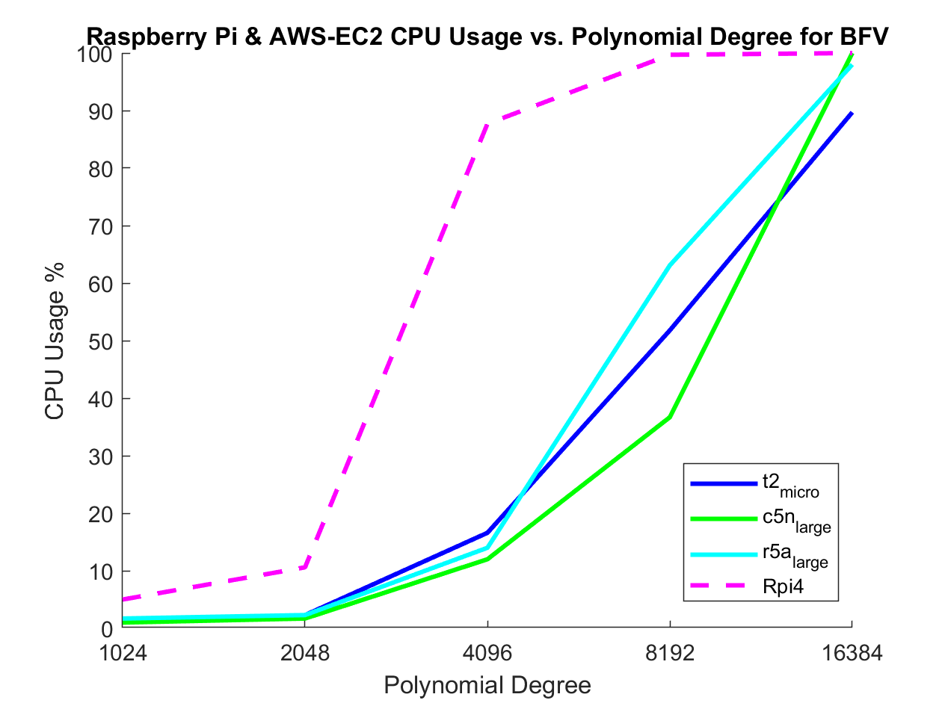
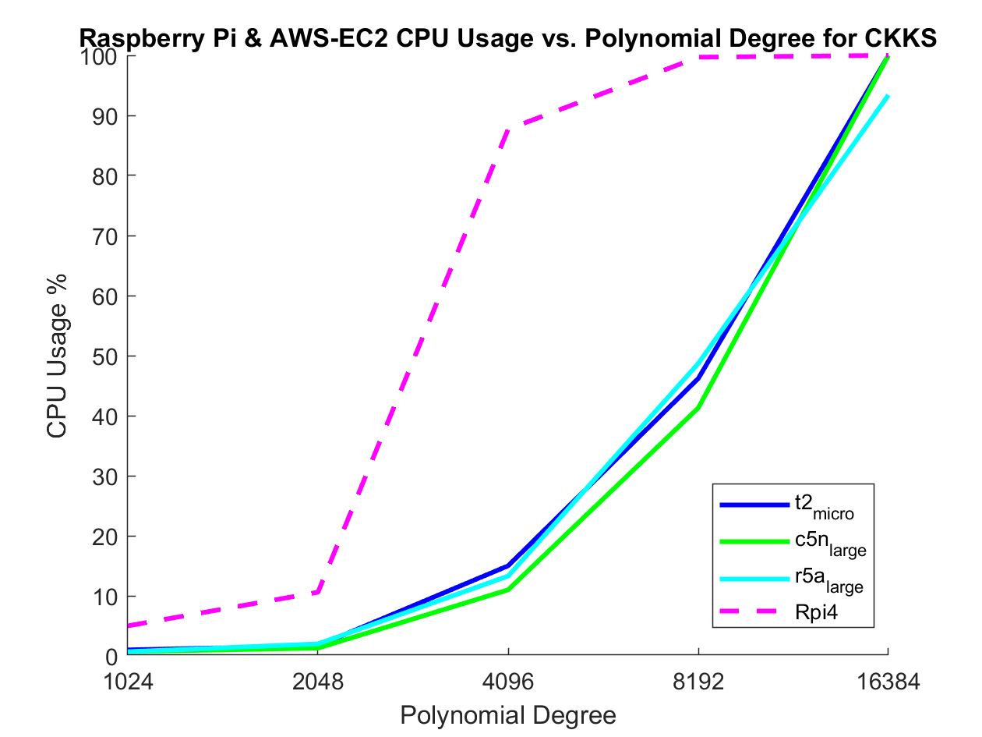
Objective 2 Results: CPU Usage
Raspberry Pi cannot complete 32k polynomial degree. AWS EC2 instances can complete without crashing but with long delay times (10s +) for each run.
CPU utilization approaches 100% for all current platforms, including computationally optimized and memory optimized AWS EC2 instances.

Slide 28
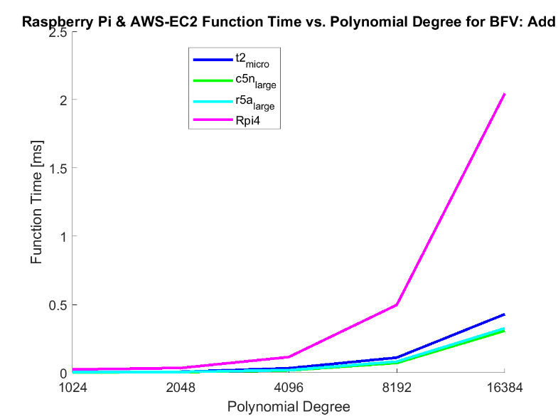
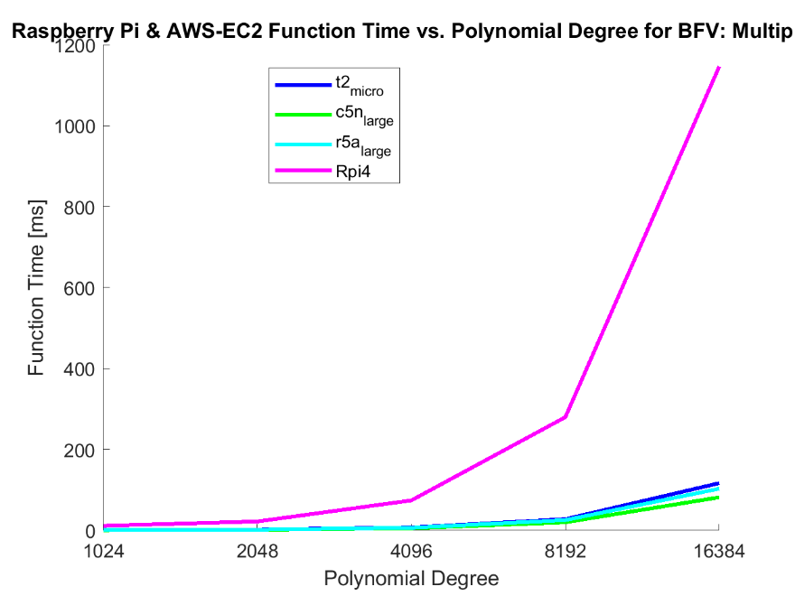
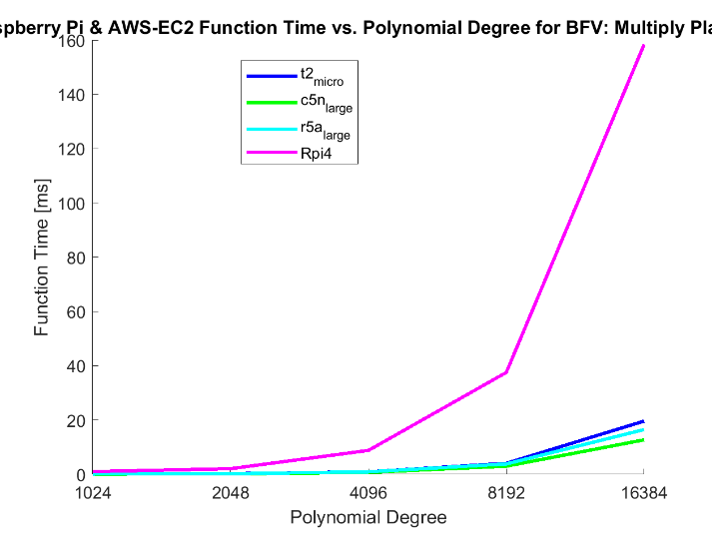

Objective 2 Results: Function Computation Time

Slide 29
Objective 3

Slide 30
Objective 3: Client-Server Model
Client-server model will move the bulk of the calculations from the resource-constrained Raspberry Pi to the AWS EC2 server and from micro AWS EC2 client and high performance AWS EC2 server.
Intended to lessen the computational cost on each device to allow a homomorphic solution for small SWaP devices

Slide 31
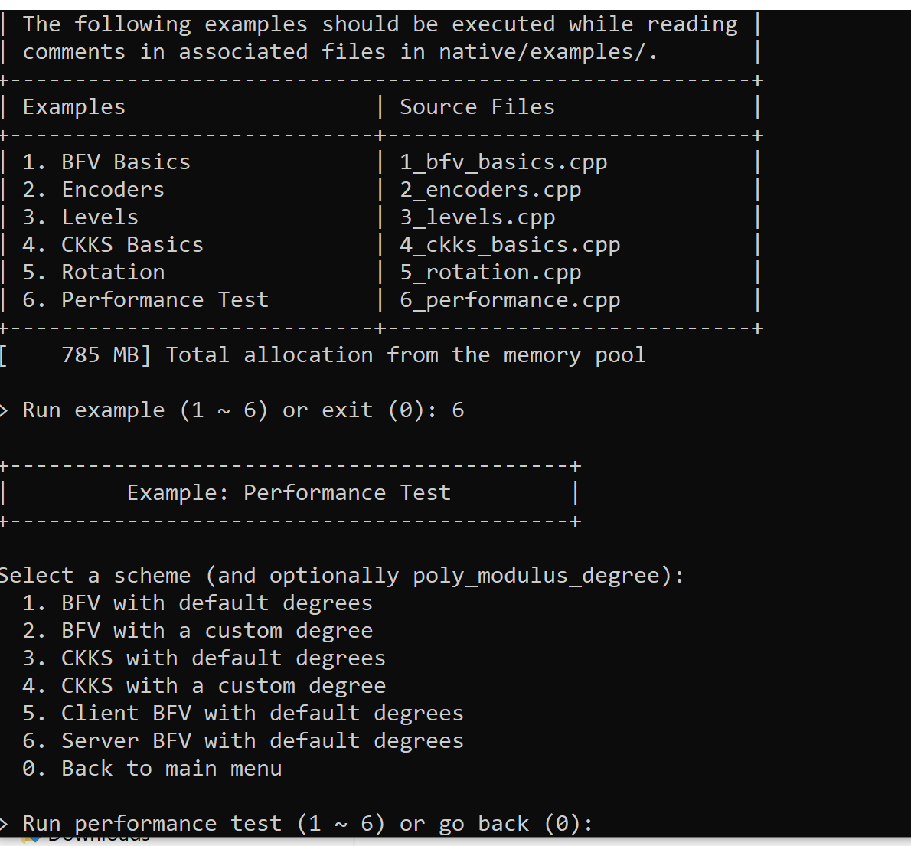
Objective 3: Implementation
Client BFV with 4096 default degree test and server BFV with 4096 default degree test added to SEAL library functions

Slide 32
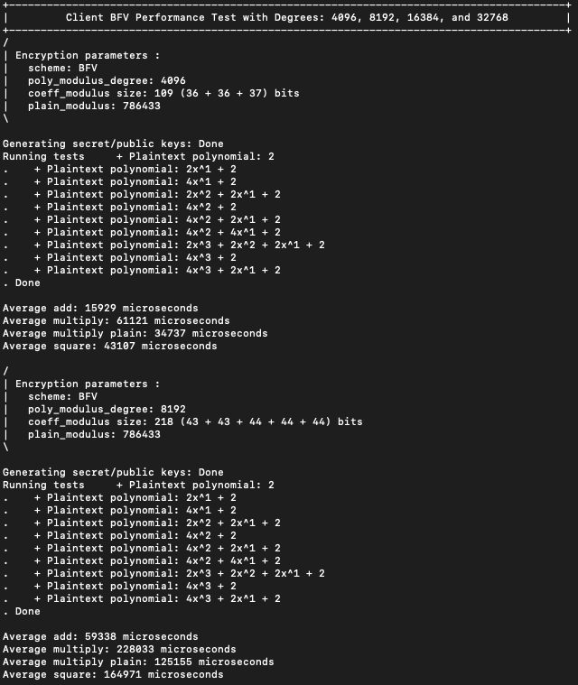
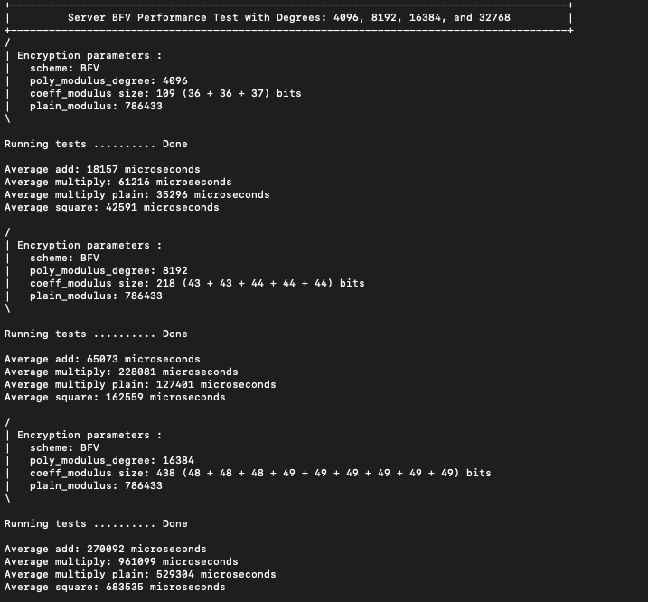
Objective 3: Client-Server Implementation

Slide 33
Objective 3: Client Server Results Table (c5n shown)
# | Parameter | SEAL BFV Degree (Client) Computation Time [ms]
Degree |  | 1024 | 2048 | 4096 | 8192 | 16384
5 | Average Add | 13.002 | 0.226 | 0.539 | 1.895 | 7.71
6 | Average Multiply | 43.559 | 2.106 | 6.294 | 23.639 | 98.195
7 | Average Multiply Plain | 87.966 | 42.817 | 18.324 | 5.619 | 23.462
8 | Average Square | 83.679 | 44.901 | 4.321 | 16.539 | 69.679
13 | CPU Usage [%] | 15.1% | 20.4% | 34.2% | 38.7% | 42.4%
# | Parameter | SEAL BFV Degree (Server) Computation Time [ms]
Degree |  | 1024 | 2048 | 4096 | 8192 | 16384
5 | Average Add | 13.245 | 0.712 | 1.971 | 5.667 | 19.364
6 | Average Multiply | 40.085 | 2.221 | 6.708 | 25.129 | 103.67
7 | Average Multiply Plain | 86.588 | 42.386 | 18.429 | 6.14 | 25.528
8 | Average Square | 88.393 | 44.865 | 4.19 | 15.996 | 67.72
13 | CPU Usage [%] | 27.3% | 30.5% | 45.7% | 60.2% | 72.4%

Slide 34
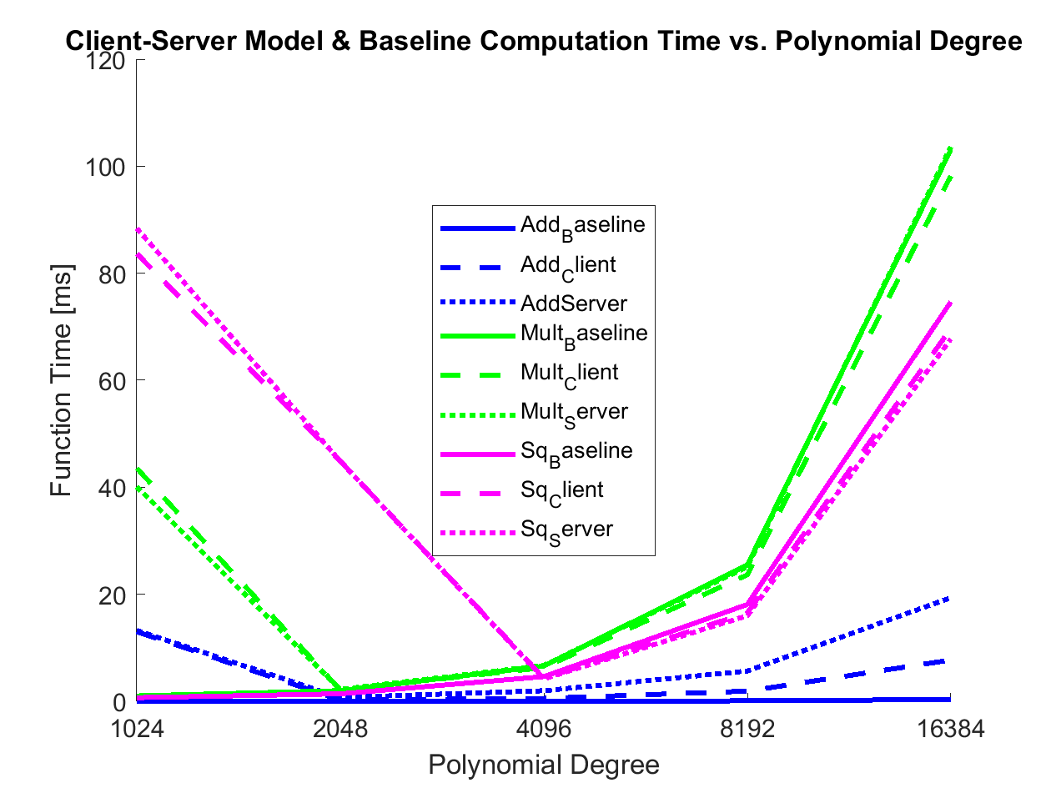
Objective 3: Results – Function Time vs. Baseline

Slide 35
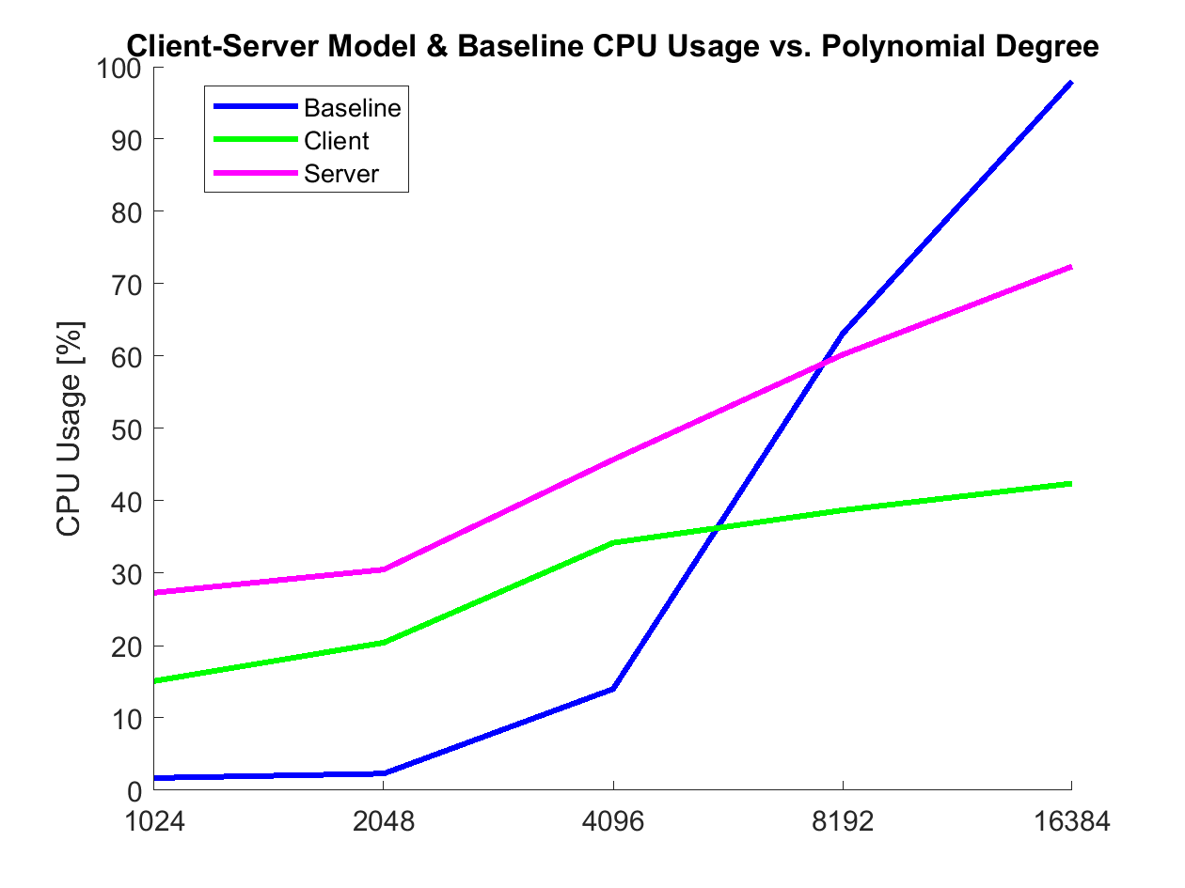
Objective 3: Results – CPU Usage

Slide 36
Summary

Slide 37
Future Work
Optimization of the SEAL library functions for to improve resource freeing and reallocation
Improvement of Raspberry Pi platform resource allocation
Implementation on IoT device app for in-situ encrypted data usage

Slide 38
Summary
Homomorphic encryption has made advancements in the past decade for implementation.
Understood from mathematical perspective
Can now optimize for resource-constrained environments
Client-server model prototype can allow for future IoT device platforms to make use of homomorphic encryption and optimize for practical use.

Slide 39
GitHub File Structure
README.txt
209AS_FinalPresentation.pptx
209AS_FinalReport.docx
Client-Server Model <software folder>
Console data logs <text file data folder>
https://github.com/daniel-achee/ece209-project.git
https://daniel-achee.github.io/ece209-project/

Slide 40
Division of Labor
Presentation & Report:
Primary: J. Quintana
Supporting: D. Achee
Objective 1:
Primary: J. Quintana
Supporting: D. Achee
Objective 2:
Primary: D. Achee
Supporting: J. Quintana
Initial AWS-EC2 instance implementation done by D. Achee, data shown from J. Quintana AWS-EC2 instances.
Objective 3:
Server side: D. Achee
Client side: J. Quintana
Client-server model done by D. Achee, Rpi platform side done by J. Quintana

Slide 41
References
[1] P.V. Parmar, et. Al., “Survey of Various Homomorphic Encryption Algorithms and Schemes”, International Journal of Computer Applications, (0975-8887), Vol. 81, No. 8, April 2014.
[2] C. Gentry, “Fully Homomorphic Encryption Using Ideal Lattices”, Stanford University, IBM Watson, 2009.
[3] K. Lauter, et. Al., “Can Homomorphic Encryption be Practical?” Microsoft Research, Eindhoven University of Technology, University of Toronto, 2011.
[4] N. Downlin, et. Al., “Manual for Using Homomorphic Encryption for Bioinformatics”, Microsoft Research, Princeton University, accessed Jan 2020.
[5] Z. Brakerski and V. Vaikuntanathan, “Efficient Fully Homomorphic Encryption from (Standard) LWE”, SIAM Journal on Computing, Vol. 43, No. 2, 831-871, 2014.
[6] J. Howe, et. Al., “On Practical Discrete Gaussian Samplers for Lattice-Based Cryptography”, IEEE Transactions on Computers, Vol. 67, No. 3, March 2018.
[7] S. Fau, et. Al., “Towards practical program execution over fully homomorphic encryption schemes”, Eighth International Conference on P2P, Parallel, Grid, Cloud and Internet Computing, 2013.
[8] K. Laine, et. Al., “Simple Encrypted Arithmetic Library 2.3.1”, Microsoft Research, 2018.
[9] A. Prasitsupparote, et. Al., “Implementation and Analysis of Fully Homomorphic Encryption in Wearable Devices”, Proceedings of 4th International Conference on Information Security and Digital Forensics, ISDF2018, Greece, 2018.

